Slide 1
INTRODUCTION TO BIOTECHNOLOGY
BHARTI ANAND
ASSISTANT PROFRSSOR ,ZOOLOGY DEPT
DEVA NAGRI COLLEGE MEERUT

Slide 3
DEFINITION
The biotechnology is derived from fusion of biology and technology.
Biotechnology is “the integrated use of biochemistry, microbiology and engineering sciences in order to achieve technological application of the capabilities of micro-organisms, cultured tissues/cells and parts thereof.”
-European Federation of Biotechnology

Slide 4
HISTORY
Man began employing the micro-organisms as early as5,000 BC for making wine, vinegar, curd leavened bread etc.
During First war, Germans developed the technology for glycerol (needed for manufacturing explosives)production.
After First War technology for citrus acid production using Aspergillus niger
was developed.
Antibiotic penicillin by Penicillium notatum was discovered in 1930 by Fleming.
Discovering micro-organisms with novel capabilities led to the development of recombinant DNA technology allow man to modify micro-organisms to create them highly valuable ,novel and naturally non-existent capabilities.

Slide 5
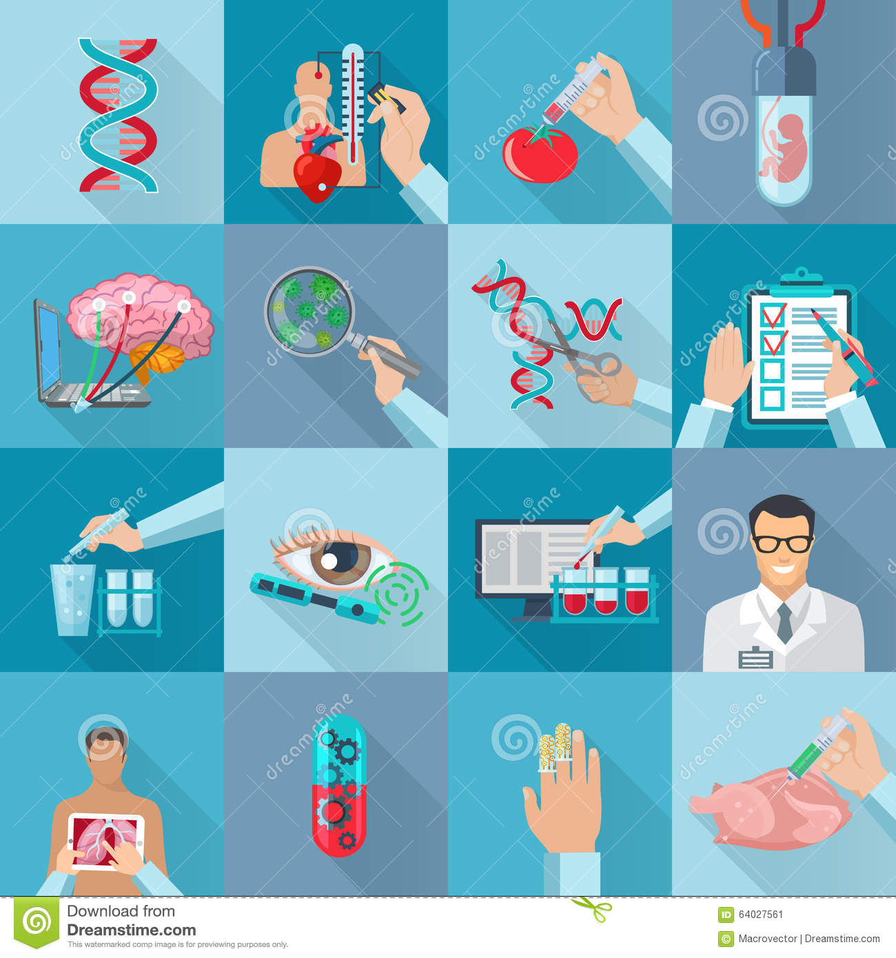
SCOPE AND IMPORTANCE
Biotechnology has rapidly emerged as an area of activity having a marked realized as well as potential impact on virtually all domains of human welfare, ranging from food processing, protecting the environment to human health.
As a result , it now plays very important role in employment, production and productivity, trade, economics and economy, human health and the quality of human life throughout the world.

Slide 6
A list of some important areas in which biotechnology is making marked contribution
Human health
Medicines
Animal health
Dairy
Animal husbandry
Chemicals and biochemicals
Food processing and beverages
Crimes and parentage disputes
Agriculture
Forestry
Horticulture and floriculture
Environment
Renewable energy and fuels
Population control
Mining
Fisheries and aquaculture

Slide 7
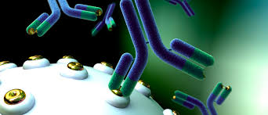
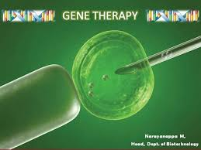

Slide 8
Continued…
Monoclonal antibodies( used for diseases, e.g., hepatitis B, cancer etc)
DNA probes
Recombinant vaccines
Valuable drugs like human insulin, human interferon etc.
Gene therapy to cure genetic diseases.
Artificial insemination with X or Y carrying sperms prepared by sperm separation techniques
DNA fingerprinting.

Slide 9
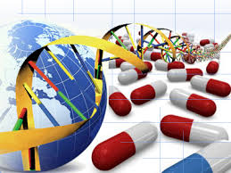
INDUSTRIAL BIOTECHNOLOGY
Production of useful compounds e.g., ethanol, citric acid glycerol etc.
Production of antibiotics
Production of useful enzymes.
Single cells proteins.
Mineral extraction through leaching
Production of immunotoxins.

Slide 10
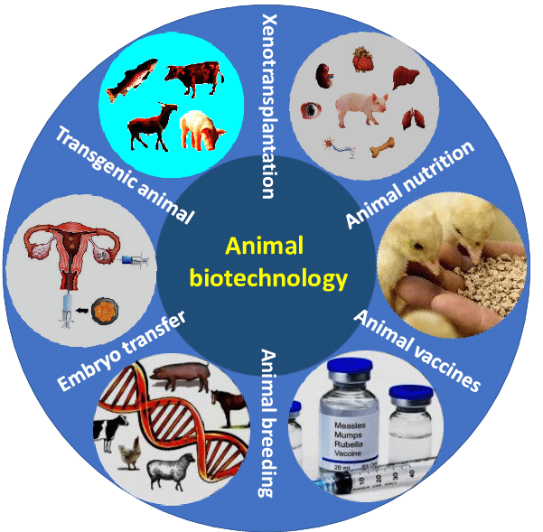
ANIMAL BIOTECHNOLOGY
Test tube babies in human.
Embryo transfer.
Hormone induced ovulation.
Production of transgenic animals.
Animal breeding.
Embryo splitting in farm animals.
Production of some valuable proteins in milk/urine/blood.

Slide 11
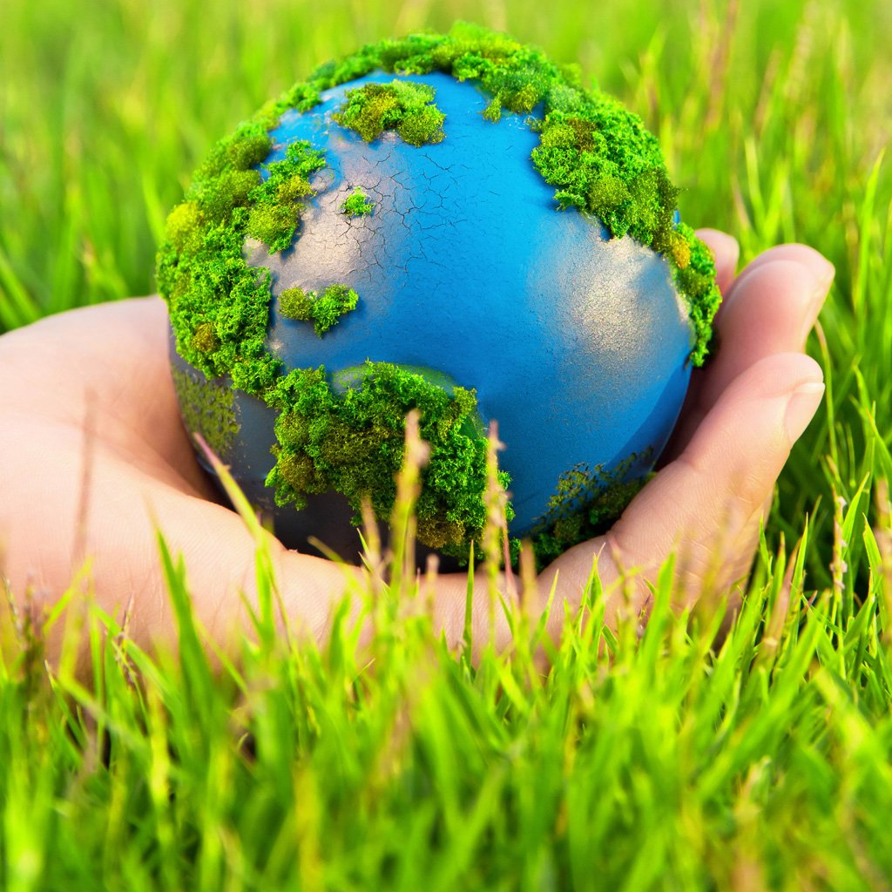
ENVIORNMENTAL BIOTECHNOLOGY
Environment sewage treatment, deodorization of human excreta.
Degradation of petroleum and management of oil spills.
Detoxification of wastes.
Detoxification of industrial effluents.
Biocontrol of plant diseases and insect pests.

Slide 12
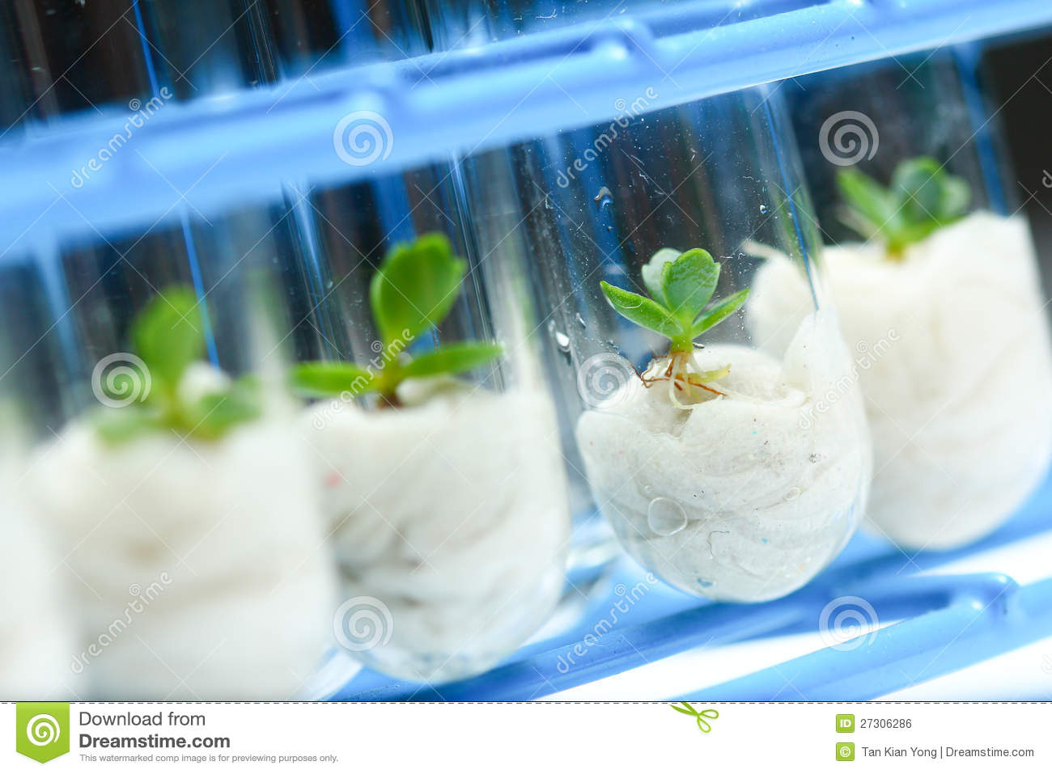
PLANT BIOTECHNOLOGY
Embryo culture.
Rapid clonal multiplication through meristem.
Germplasm conservation.
Isolation of homozygous lines by chromosome doubling of haploids.
Gene transfers.
Molecular markers like, e.g., RFLPs and RAPDs for linkage mapping .

Slide 13
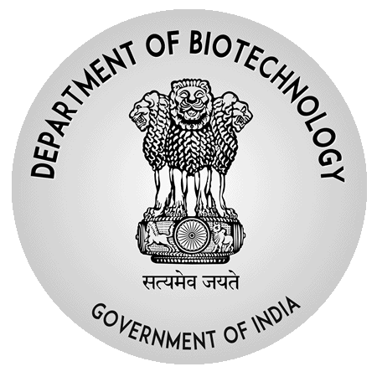
BIOTECHNOLOGY IN INDIA
In 1986, a separate Department of Biotechnology was created within the ministry of Science and technology.
Research centres for biotechnology have been organised at –
( 1) IARI, New Delhi; (2) NDRI ,Karnal; (3) IVRI, Bareilly, UP
The first autonomous institute, the National Institute of Immunology which was set up in 1981 was brought under the wings of DBT.
National Facility for Animal Tissue and Cell Culture of Pune formed in 1986 which was later christened the National Centre for Cell Science.
The late 1990s and early 2000 saw many other institutes like The National Institute for Plant Genome Research (NIPGR), the National Brain Research Centre (NBRC) followed, the Centre for DNA Fingerprinting & Diagnostics, Institute of Bioresources and Sustainable Development and the Institute of Life Sciences take shape.

